Slide 1
IKAC WORKS – FREELANCING APPLICATION USING MERN
BY
1.CHOCKALINGAM S RM (110121104022)
2.IKRAM MUSTAFA HUSSAIN A (110121104027)
3.KAMALESHWARAN S (110121104032)
4.MOHAMED ABDULLAH F (110121104039)

Slide 2
INTRODUCTION
IKAC Works is a freelancing platform designed to connect clients with skilled freelancers. It provides an intuitive interface for project posting, bidding, and seamless collaboration. With a dedicated admin team focused on ensuring security and effective communication, IKAC Works strives to be the preferred platform for both clients and freelancers.

Slide 3
MERN STACK
React.js | Node.js and Express.js | MongoDB
Powerful, component-based front-end framework for building user interfaces. | Scalable, event-driven runtime and web application framework for the back-end. | NoSQL database for flexible and scalable data storage and management.

Slide 4
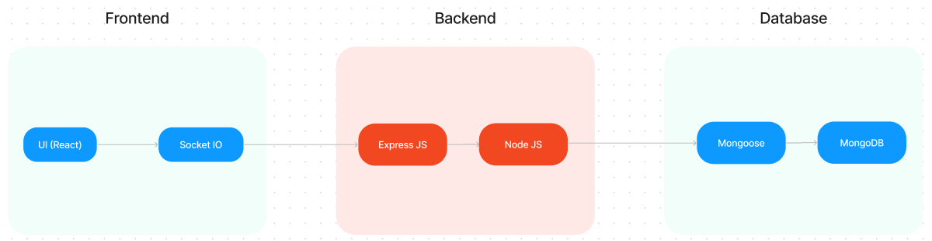
TECHNICAL ARCHITECTURE

Slide 5
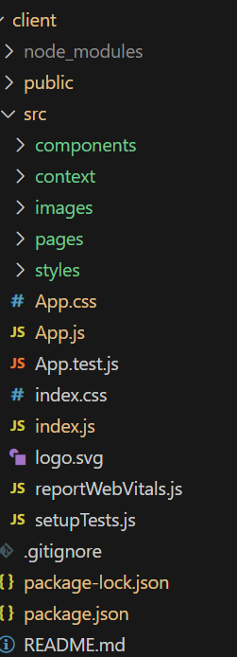
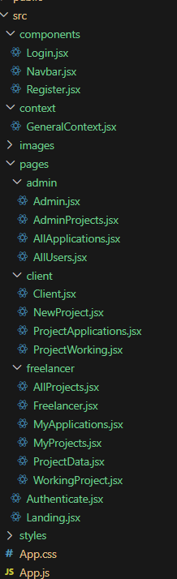
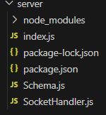
PROJECT STRUCTURE
CLIENT SIDE :
SERVER SIDE:

Slide 6
PRE-REQUISITES
Node.js and npm, Express.js, MongoDB, React.js
Navigate into the cloned repository directory:
cd freelancer-app-MERN
Install the required dependencies by running the following commands:
../cd client
npm install
../cd server
npm install
Start the Development Server: npm start
IKAC Works app will be accessible at http://localhost:3000

Slide 7
REGISTRATION AND LOGIN:
Registration
Secure and intuitive user registration process, collecting necessary information.
Login
Seamless login experience with options for email, social, or third-party authentication.
User Profiles
Customizable user profiles showcasing freelancer skills, experience, and portfolio.

Slide 8
POSTING AND APPLYING FOR FREELANCE JOBS
Job Posting
Clients can create and publish freelance job opportunities with detailed requirements.
Job Search
Freelancers can browse and filter available job postings based on their skills and interests.
Proposal Submission
Freelancers can submit their proposals and bids for the selected job opportunities.

Slide 9
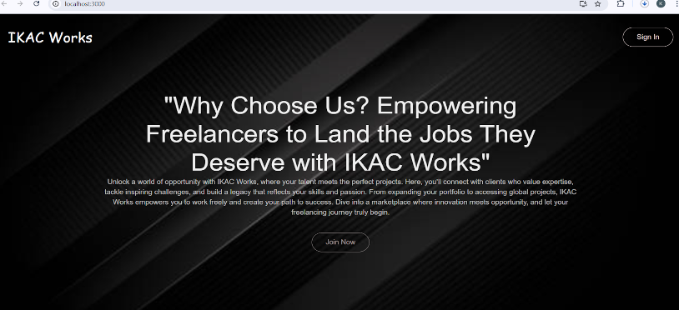
PROJECT IMPLEMENTATION
LANDING PAGE :

Slide 10
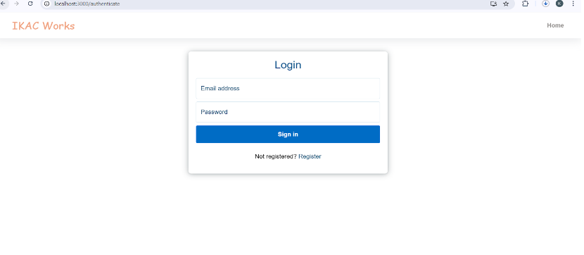
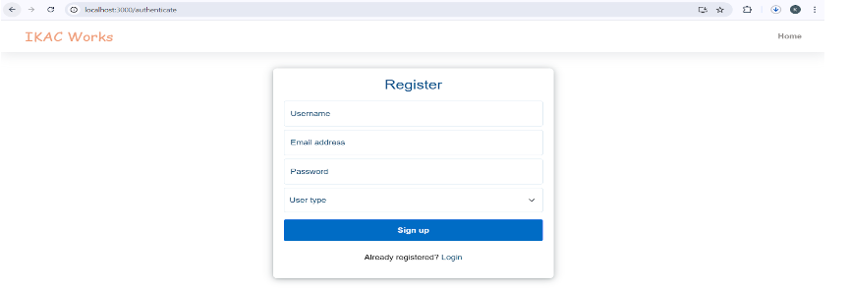
LOGIN PAGE:
REGISTER PAGE:

Slide 11
CONCLUSION AND FUTURE ENHANCEMENTS
Conclusion :
The MERN-based freelancing application provides a comprehensive platform for both freelancers and clients to connect, collaborate, and succeed.
Future Enhancements :
Potential enhancements include advanced search and filtering, project management tools, and integration with popular payment gateways.

